Slide 1
Name: You Chehnintchesda
GEN: 11
Department: CS
Specialization: DS
Group:2

Slide 2
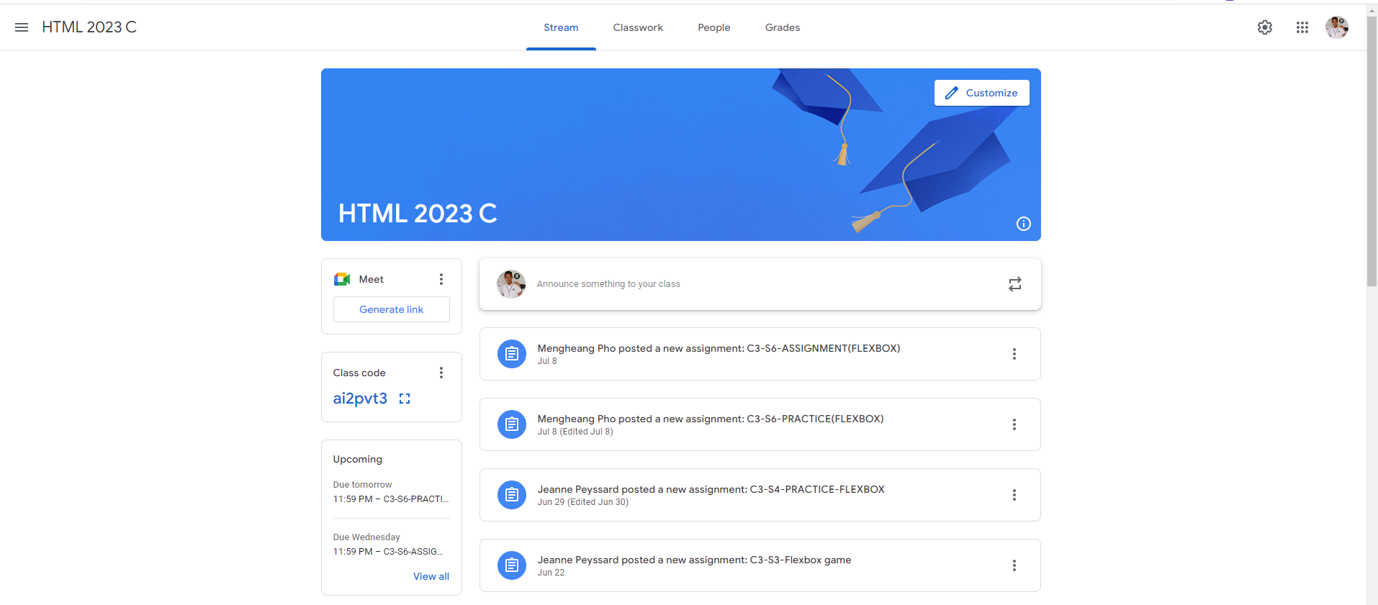
Identify root components of website below

Slide 3
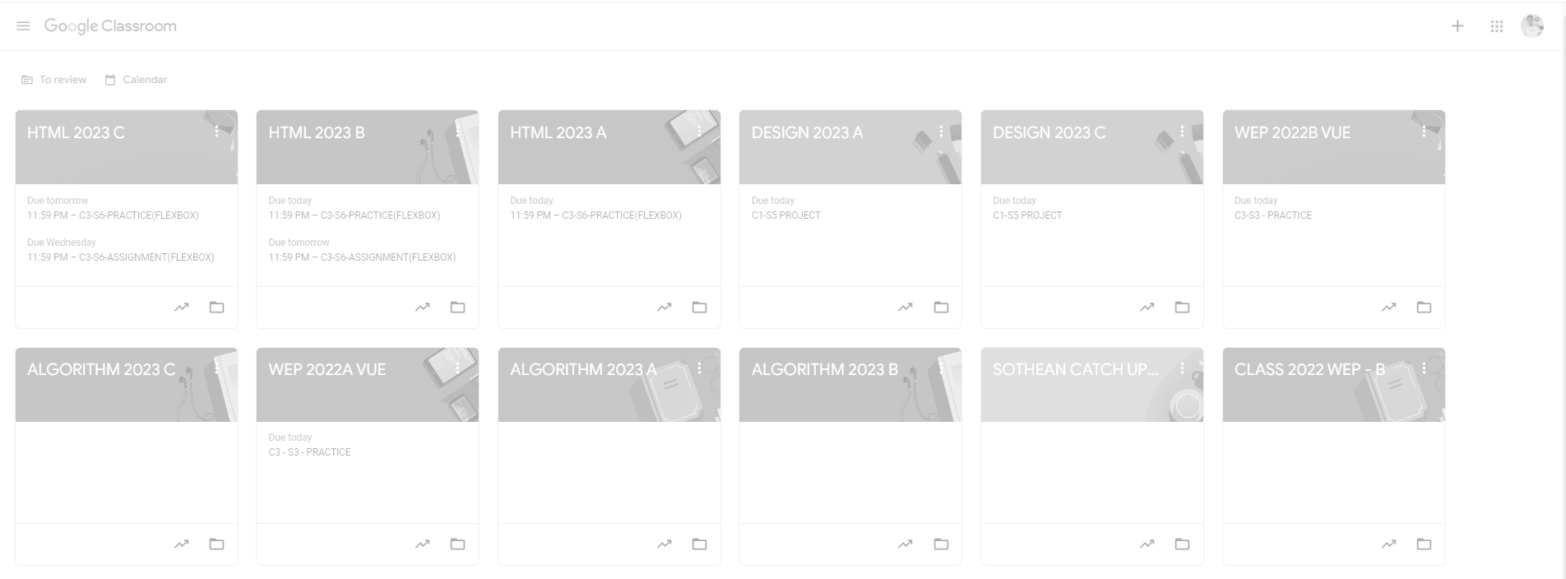
Root div
- Height: 100vh
content
nav
Flex: 0
header
Flex: 0
Flex: 1

Slide 4
Nav
Nav-left
Nav-center
Nav-right
Flex: 0
Flex: 1
Flex: 0
Nav-left
Nav-center
Nav-right
Setting
Menu
Calss-title
Active Tab
Tab
More
Profile

Slide 5
Header
Customize button
Header
Title
Background Image
Main Section

Slide 6
Content
Left-section
Right-section
Content Header
Flex:0
Flex:1
Main Section
Flex-direction: row

Slide 7
Left-section
Right-section
Flex-direction: column
Flex-direction: column
Content Header
Google Meet
Announcement
Class code
Assignments
Schedule
Main Section

